Slide 1
Lecture 5: Binomial options pricing model
人工智慧理論與實務

Slide 2
5.1 An Introduction to Binominal Trees
Binomial trees are popular technique to approximate the movements in the price of a stock, options, or other assets.
This is a diagram representing different possible paths that might be followed by the stock price over the life of an assets.
For pricing an option, the underlying assumption is that the stock price follows a random walk.
The main idea of binomial option pricing theory is pricing by arbitrage. If one can formulate a portfolio to replicate the payoff of an option, then the option price should equal to the price of the replicating portfolio if the market has no arbitrage opportunity.
Note: This section is based on Chapter 12, & 20 of “Options, Futures, & Other Derivatives” by J. Hull, Pearson, 7th Edition, 2012; and Chapter 4 of “財務工程與金融計算” by 張焯然, Securities & Futures Institute, RoC, 2007.

Slide 3
5.1.1 One-step Binomial Model
In each step, it has a certain probability of moving up by a certain percentage amount and a certain probability of moving down by a certain percentage amount.
Note: In the limit, as the time step becomes smaller, this model is the same as the Black-Scholes-Merton model (Pls refer to Hull’s book Ch12 appendix for the detail derivations).
where the stock price, and an option on the stock whose current price are denoted by S₀, and f.
Suppose the option lasts for time T & the stock price can either move up from S₀ to a new level, S₀u, where u > 1, or down from S₀ to a new level, S₀d, where d < 1.
The percent increase in S₀ when there is an up movement is u-1; the percent decrease when there is a down movement is 1-d.
If S₀ moves up to S₀u, the option payoff is f_{u}; if S₀ moves down to S₀d, the option payoff is f_{d}.
T
S₀u
ƒ_{u}
Stock & option prices in a general one-step tree:
S₀
ƒ
S₀d
ƒ_{d}

Slide 4

5.1.1 The Option Pricing Formula
Consider the portfolio that is long ∆ shares & short one option:
The portfolio is riskless when S₀ u∆ – ƒ_{u} = S₀ d∆ – ƒ_{d} , or $∆=\frac{f_{u}−f_{d}}{S_{0}u−S_{0}d}$
If we denote the risk-free rate by r, the PV of the portfolio is: $\left(S_{0}u∆−f_{u}\right)e^{−rT}$
$S_{0}∆−f=\left(S_{0}u∆−f_{u}\right)e^{−rT}$
$$f=e^{−rT}\left[pf_{u}−\left(1−p\right)f_{d}\right]$$
where $p=\frac{e^{rT}−d}{u−d}$
T
S₀u∆ - ƒ_{u}
S₀ ∆ – ƒ
S₀d∆ – ƒ_{d}
substitute
(5.1)

Slide 5
5.1.1 Irrelevance of the Stock’s Expected Return
The option price formula (5.1) does not involve the probabilities of the stock price moving up or down.
This is surprising & seems counterintuitive.
The key reason is that we are not valuing the option in absolute terms. We are calculating its value in terms of the price of the underlying stock.
The probabilities of future up or down movements are already incorporated into the stock price.

Slide 6
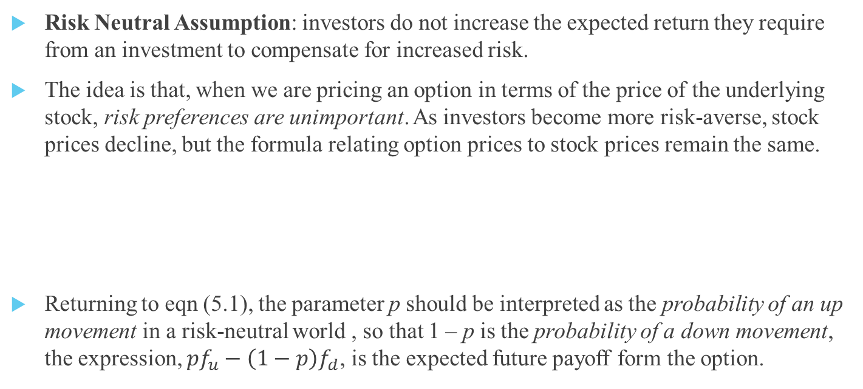
5.1.1 Risk Neutral Valuation
Risk Neutral Assumption: investors do not increase the expected return they require from an investment to compensate for increased risk.
The idea is that, when we are pricing an option in terms of the price of the underlying stock, risk preferences are unimportant. As investors become more risk-averse, stock prices decline, but the formula relating option prices to stock prices remain the same.
Returning to eqn (5.1), the parameter p should be interpreted as the probability of an up movement in a risk-neutral world , so that 1 – p is the probability of a down movement, the expression, $pf_{u}−\left(1−p\right)f_{d}$, is the expected future payoff form the option.
p
S₀u
ƒ_{u}
S₀
ƒ
S₀d
ƒ_{d}
1-p

Slide 7
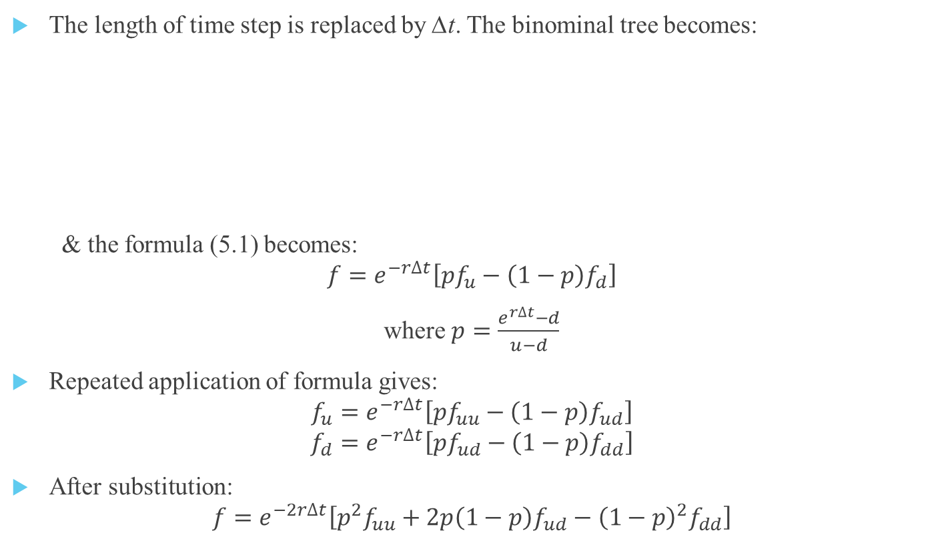
5.1.2 Two-step Binomial Model
The length of time step is replaced by ∆t. The binominal tree becomes:
& the formula (5.1) becomes:
$$f=e^{−r∆t}\left[pf_{u}−\left(1−p\right)f_{d}\right]$$
where $p=\frac{e^{r∆t}−d}{u−d}$
Repeated application of formula gives:
$$f_{u}=e^{−r∆t}\left[pf_{uu}−\left(1−p\right)f_{ud}\right]$$
$$f_{d}=e^{−r∆t}\left[pf_{ud}−\left(1−p\right)f_{dd}\right]$$
After substitution:
$$f=e^{−2r∆t}\left[p^{2}f_{uu}+2p\left(1−p\right)f_{ud}−{\left(1−p\right)}^{2}f_{dd}\right]$$
∆t
S₀u²
ƒ_{uu}
∆t
S₀u
ƒ_{u}
S₀ud
ƒ_{ud}
S₀
ƒ
S₀d
ƒ_{d}
S₀d²
ƒ_{dd}

Slide 8
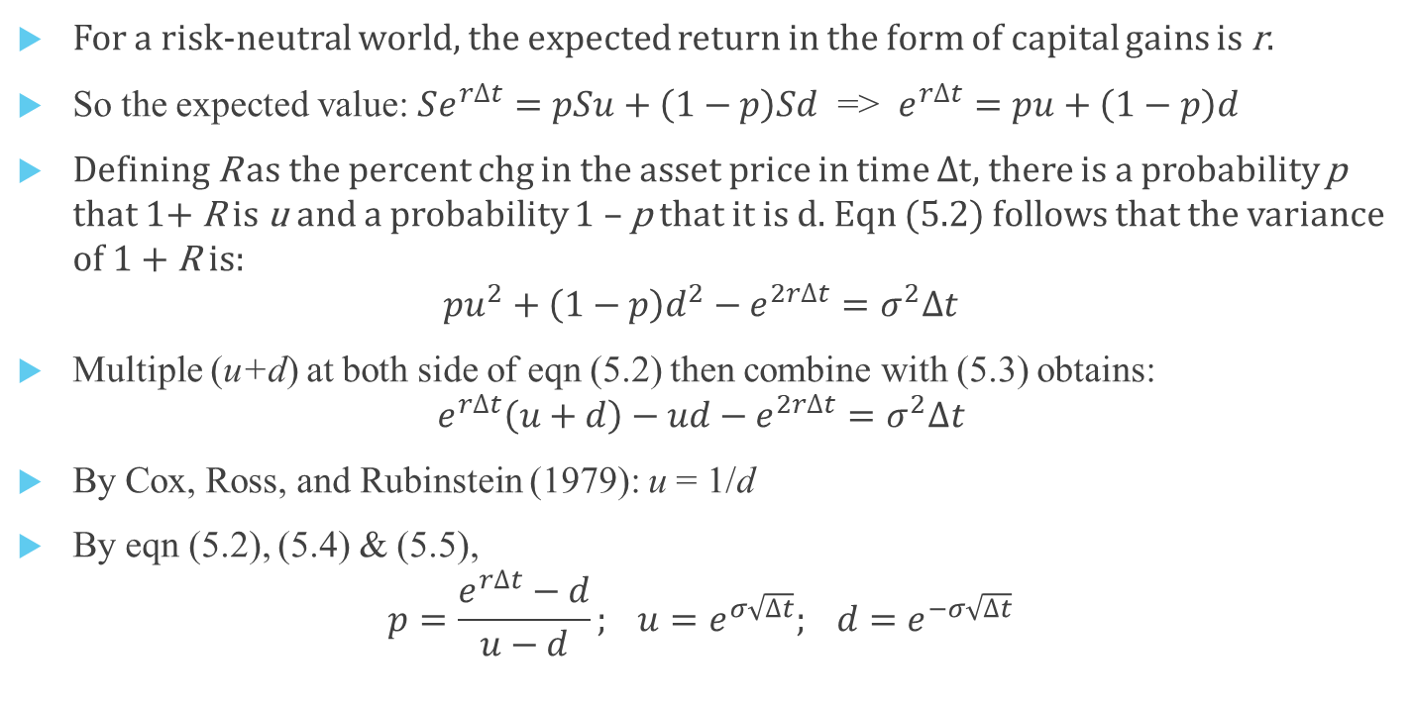
5.1.3 n-step Binomial Model (Determination of p, u, and d)
For a risk-neutral world, the expected return in the form of capital gains is r.
So the expected value: $Se^{r∆t}=pSu+\left(1−p\right)Sd$ => $e^{r∆t}=pu+\left(1−p\right)d$
Defining R as the percent chg in the asset price in time $∆$t, there is a probability p that 1+ R is u and a probability 1 – p that it is d. Eqn (5.2) follows that the variance of 1 + R is:
$$pu^{2}+\left(1−p\right)d^{2}−e^{2r∆t}=σ^{2}∆t$$
Multiple (u+d) at both side of eqn (5.2) then combine with (5.3) obtains:
$$e^{r∆t}\left(u+d\right)−ud−e^{2r∆t}=σ^{2}∆t$$
By Cox, Ross, and Rubinstein (1979): u = 1/d
By eqn (5.2), (5.4) & (5.5),
$$p=\frac{e^{r∆t}−d}{u−d}; u=e^{σ\sqrt{∆t}}; d=e^{−σ\sqrt{∆t}}$$
(5.2)
(5.3)
(5.4)
(5.5)
If you can’t understand the proof above.
Just remember the eqns of p, u, and d!

Slide 9
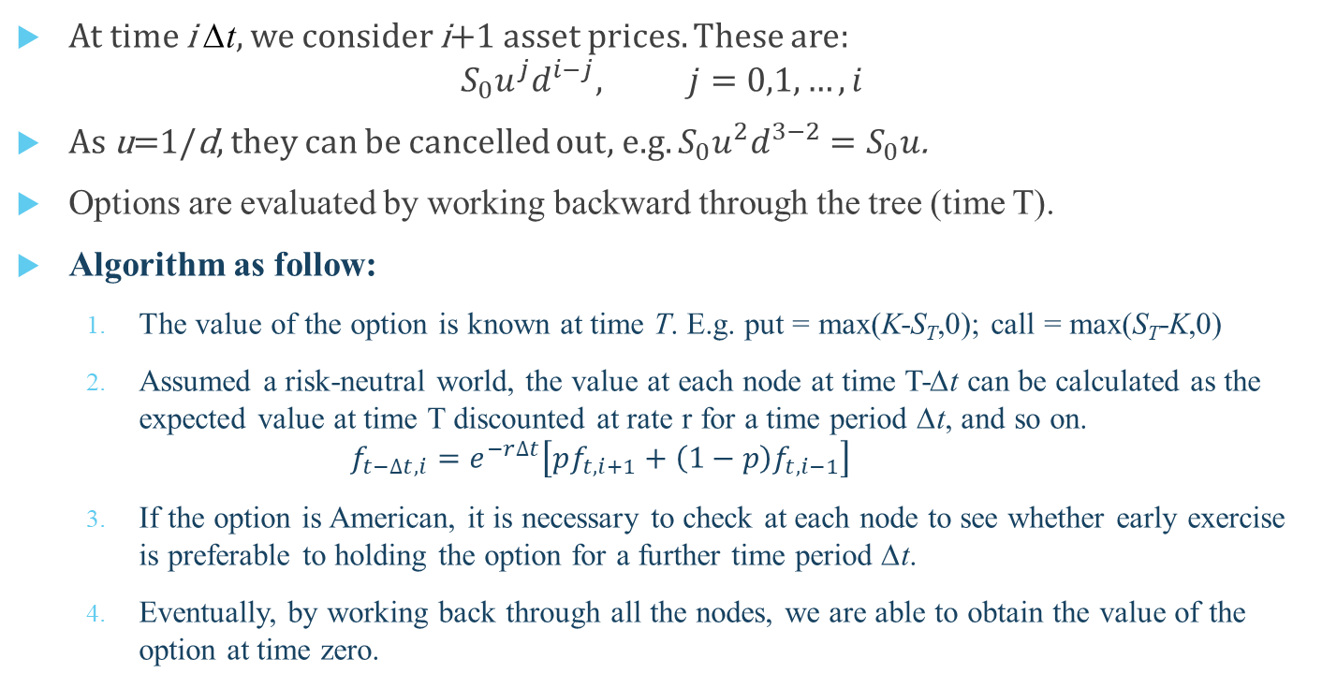
5.1.4 Tree of Asset Prices
t= 3∆t
S₀u⁴
t= 2∆t
S₀u³
t= ∆t
S₀u²
S₀u²
t=0
S₀u
S₀u
S₀
S₀
S₀
S₀d
S₀d
At time i ∆t, we consider i+1 asset prices. These are:
$$S_{0}u^{j}d^{i−j}, j=0,1,…,i$$
As u=1/d, they can be cancelled out, e.g. $S_{0}u^{2}d^{3−2}=S_{0}u$.
Options are evaluated by working backward through the tree (time T).
Algorithm as follow:
The value of the option is known at time T. E.g. put = max(K-S_{T},0); call = max(S_{T}-K,0)
Assumed a risk-neutral world, the value at each node at time T-∆t can be calculated as the expected value at time T discounted at rate r for a time period ∆t, and so on. $f_{t−∆t,i}=e^{−r∆t}\left[pf_{t,i+1}+\left(1−p\right)f_{t,i−1}\right]$
If the option is American, it is necessary to check at each node to see whether early exercise is preferable to holding the option for a further time period ∆t.
Eventually, by working back through all the nodes, we are able to obtain the value of the option at time zero.
S₀d²
S₀d²
S₀d³
S₀d⁴

Slide 10
Homework
承繼上上週的資料，試以履約價16500的買權在下列設定下，回答下列問題：
S = 16273.38
K = 16500
T = 14/365
r = 0.0166
implied volatility = 0.14134
以black-scholes model定價，與真實成交價(93.00)的誤差多少？
設計一個實驗來說明CRR binominal pricing model在不同層數設定下(n=10,100,1000）與理論值black-scholes model定價的誤差。
利用black-scholes model及差分法計算 delta (call price對s的偏微分），並以此delta說明當交易員賣出一口買權時，要買多少現股才能進行delta hedging避險
設定一個很小的dS，在其他參數不變只更改S的情況下，計算 (call(S+dS)-call(S))/dS

